Slide 1
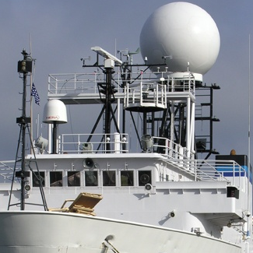
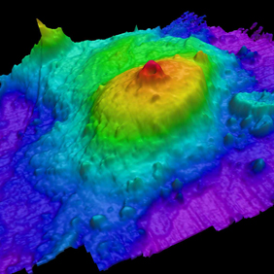
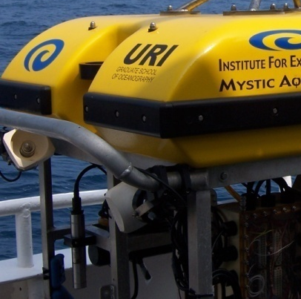
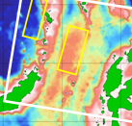
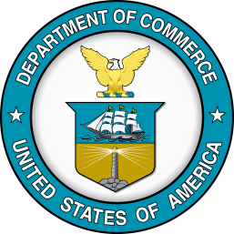
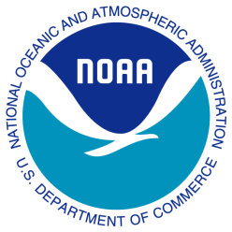
NOAA RESEARCH PERSPECTIVES: AUTONOMOUS TECHNOLOGIES FOR OCEAN OBSERVATIONS
Chris Beaverson
Acentia, LLC
Supporting: Ocean Exploration and Research Program
Office of Oceanic & Atmospheric Research
National Oceanic and Atmospheric Administration | NOAA
November 21, 2014
Notes:
Main Message: Innovation in and integration of new observing technologies is needed if NOAA is going to meet our oceanic and atmospheric observing requirements.
Segue: I want to take this time to reflect on how NOAA, and this community at large, may be able to harness the power of technology to ensure current and future observing needs are met – even in light of the challenges we’re facing in sustaining current federal budgets.

Slide 2
Outline
NOAA Research Mission
Current methods
Emerging methods
Challenges
Impacts and opportunities

Slide 3
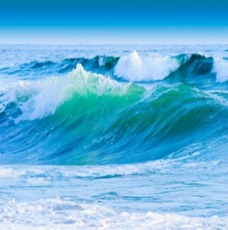
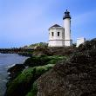
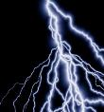
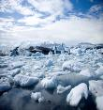

NOAA MISSION
Understand and predict changes in climate, weather, oceans, and coasts
Share that knowledge and information with others
Conserve and manage coastal and marine ecosystems and resources
National
Ocean
Service
National
Weather
Service
National Environmental
Satellite,
Data, &
Information
Service
Office of
Oceanic &
Atmospheric
Research
National
Marine
Fisheries
Service
Office of
Program
Planning &
Integration
Notes:
Main Message: We strive to answer these questions to help realize NOAA’s vision for healthy ecosystems, communities, and economies that are resilient in the face of change.
Segue: NOAA has identified 4 goals…
Main Message: To that end, NOAA has identified four goals:
(OCEANS) Marine fisheries, habitats, and biodiversity sustained within healthy ecosystems,
(WEATHER) A society that is prepared for and responds to weather-related events – a Weather-Ready Nation,
(COASTS) Coastal and Great Lakes communities that are environmentally and economically sustainable, and
(CLIMATE) An informed society anticipating and responding to climate and its impacts.
Segue: Environmental intelligence

Slide 4
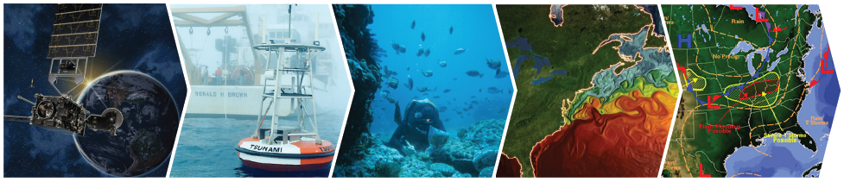


Environmental Intelligence
MONITORING
MODELING
OBSERVATIONS
ASSESSMENT
FORECAST &
PRODUCTS
Notes:
Main Message: The scientists at NOAA Research are among the most innovative in the world. We contribute to the American people daily by providing outstanding science innovation and products, enabling NOAA to be a leading provider of environmental intelligence in the atmosphere, weather, oceans, and climate. The public relies on us.
Our scientists and engineers not only take observations but design novel observing systems. They undertaken multi-year, multi-disciplinary studies and develop leading models to advance our understanding of the earth system and to predict changes in the system and to improve our forecast of hazardous events from hurricanes to harmful algal blooms.
Images:
Observations: GOES-R satellite
Monitoring: DART Buoy
Assessment: NOAA Diver collecting data on corals.
Modeling: GFDL model on sea surface temperature
Forecast & Products: NWS forecast alerts of severe storms and flooding.
Segue: Diverse maritime observing presence

Slide 5
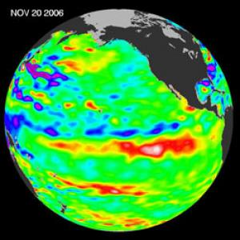
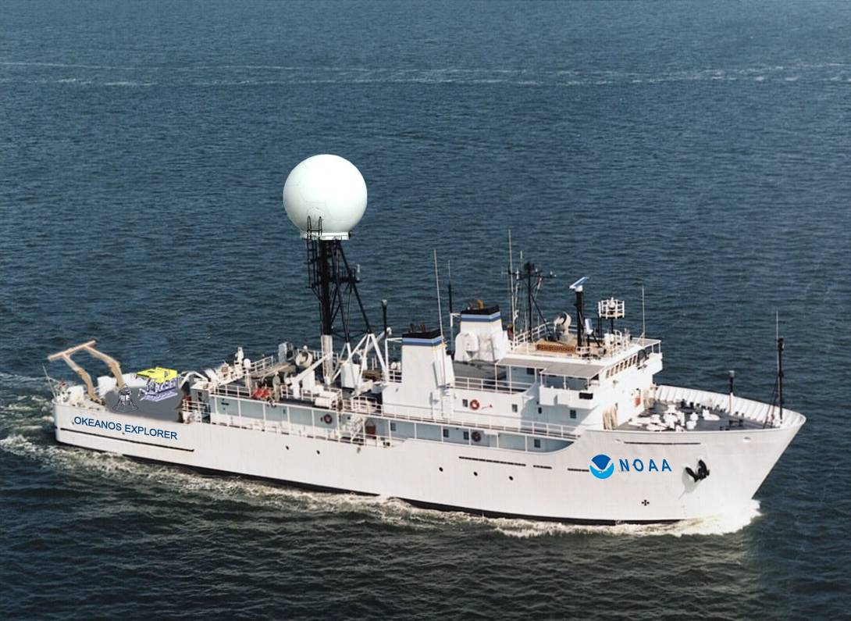
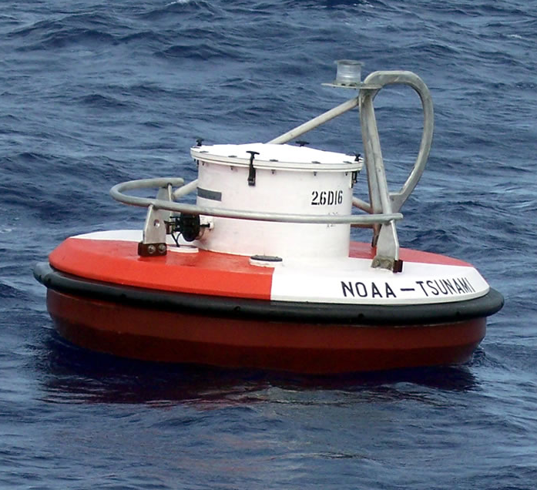
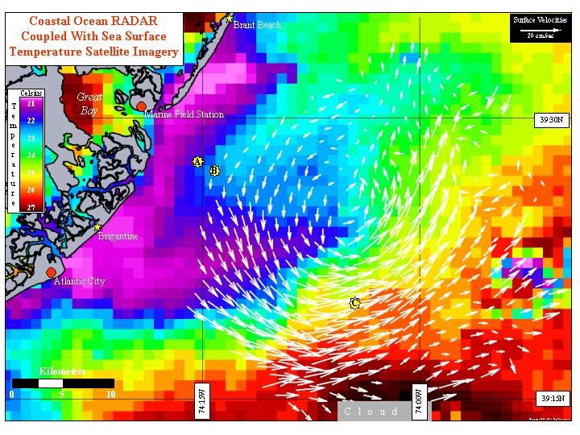
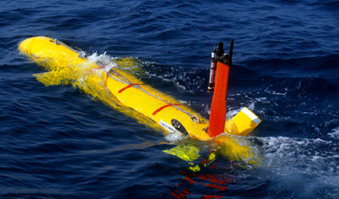
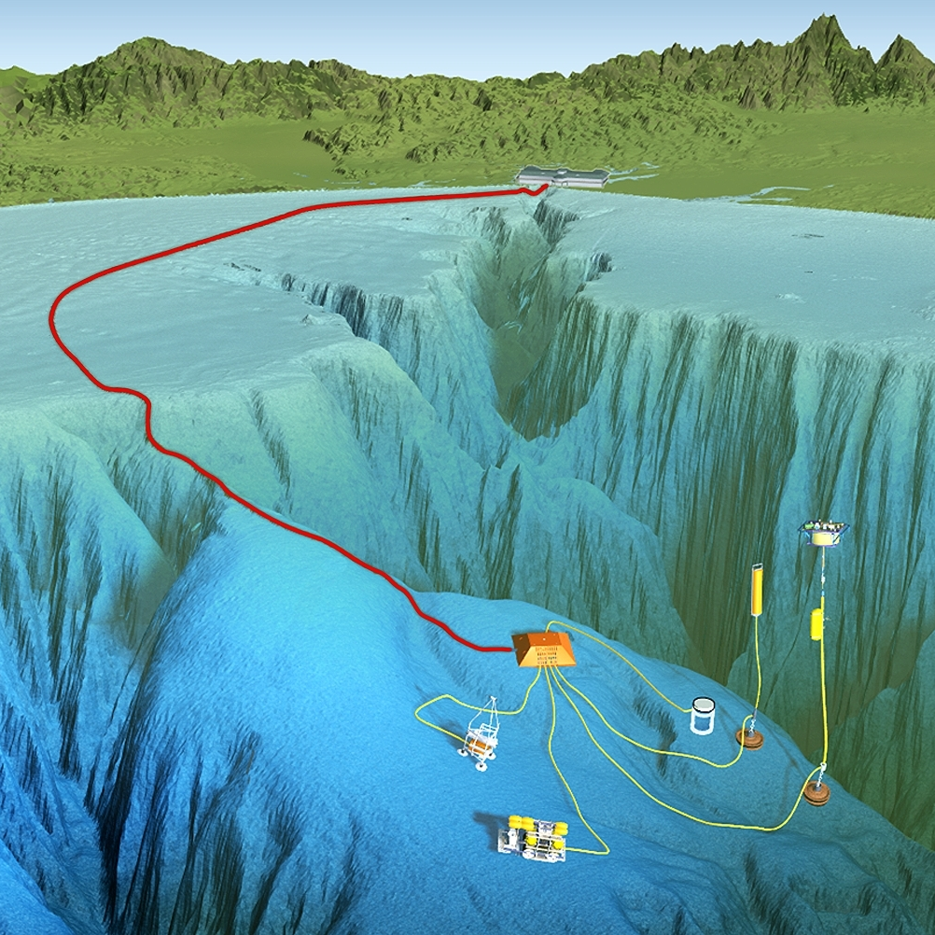
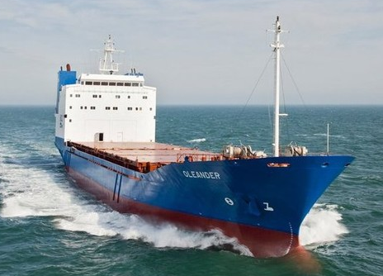
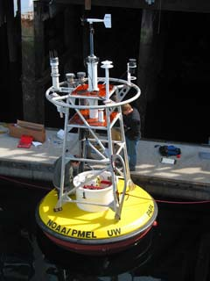
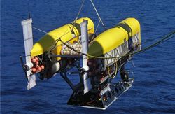
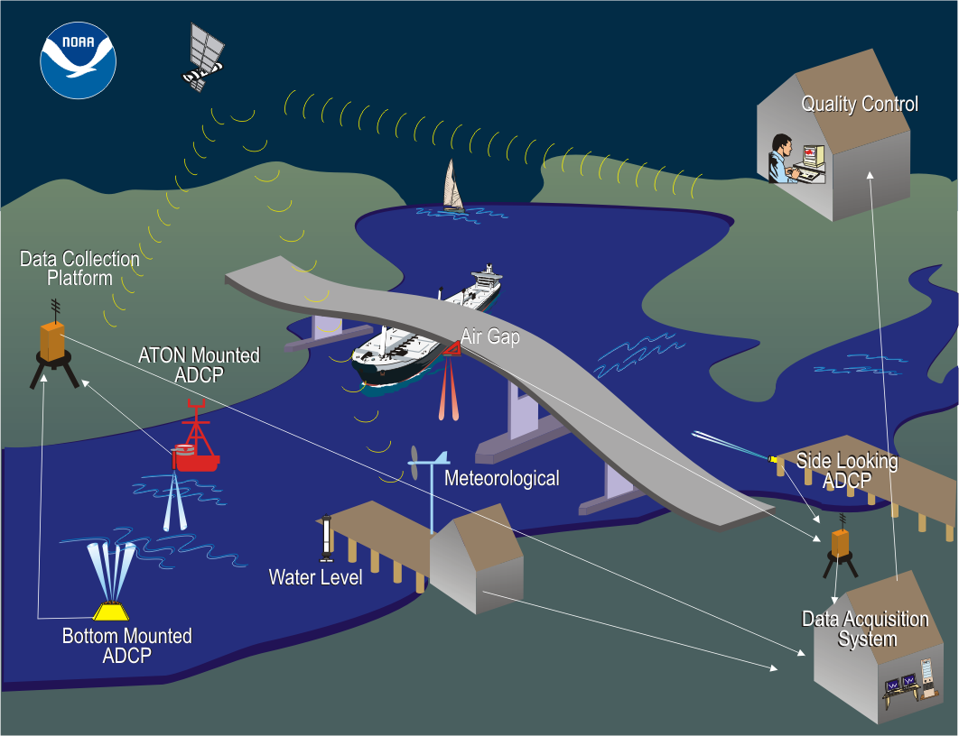
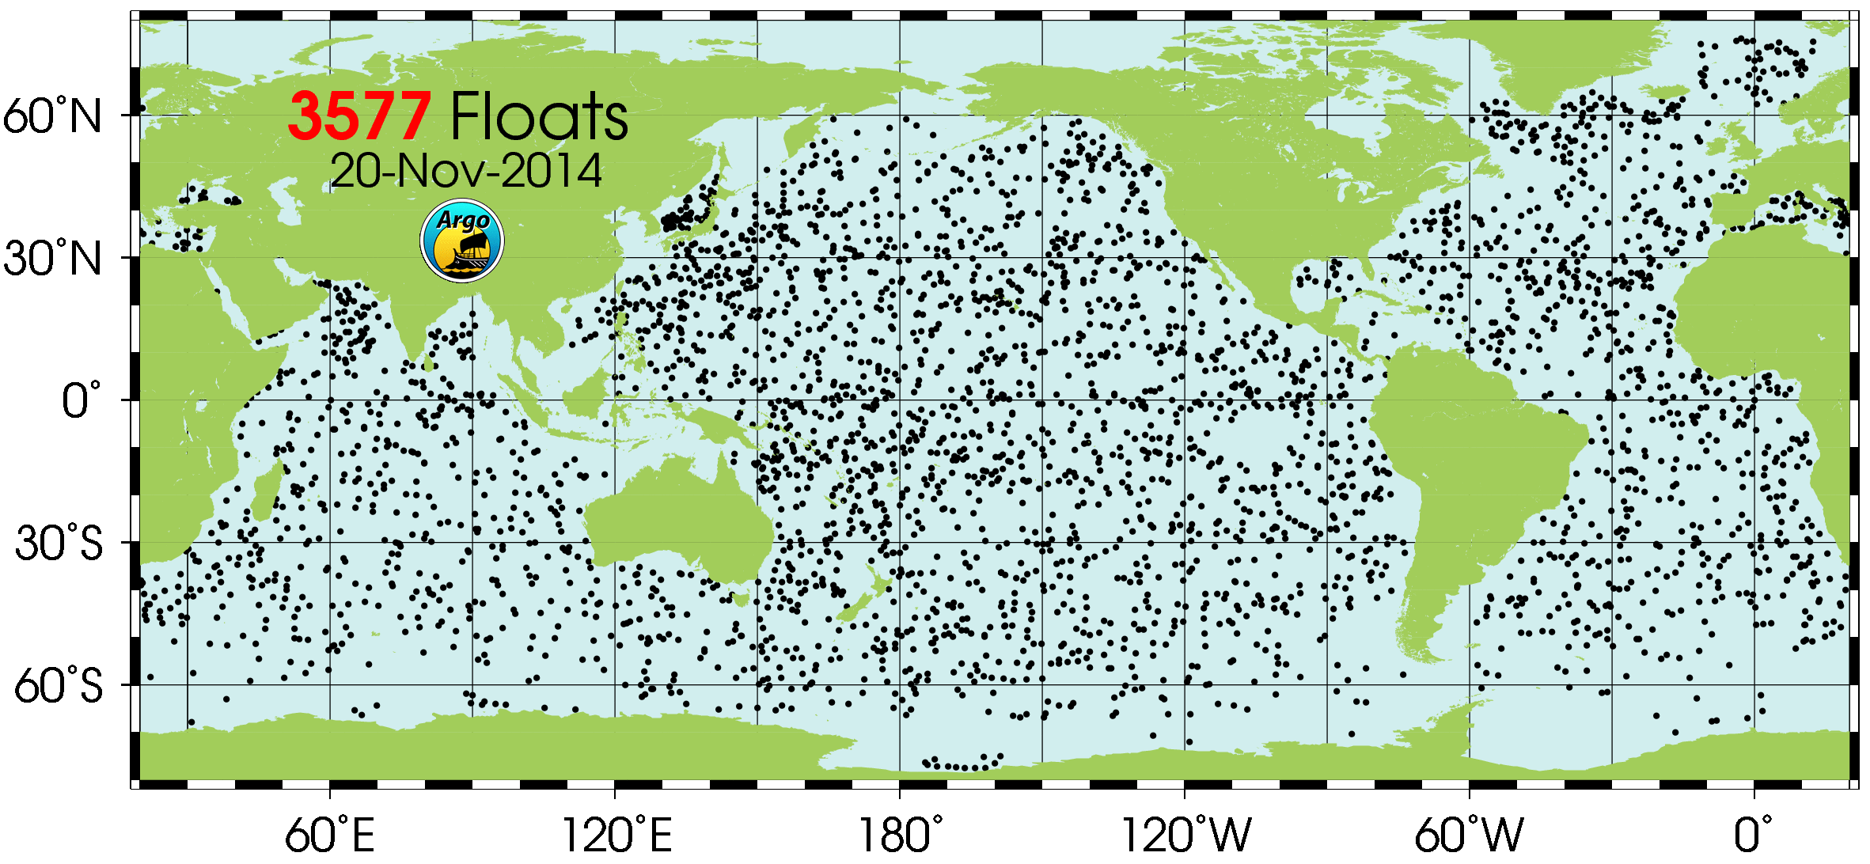
Diverse maritime observing presence
Credit: David Fierstein, MBARI
Notes:
Main Message: Diverse set of tools
NOAA has 16 ships in ten homeports on all three coasts. These ships support nautical charting, fisheries research, marine environmental assessments, coastal ocean circulation studies, and oceanographic and atmospheric research.
NOAA is using a variety of unmanned systems to supplement our ships and aircraft and yet, this is still not enough. There are gaps in our capabilities.
And NOAA is one of many partners in ocean observing and research
Add figure on weather/DART buoys and IOOS glider ops.
Segue: NOAA Research (OAR) mission areas

Slide 6
NOAA Research: Ocean Observing Mission Areas
Climate and Ocean Measurements
  Air – sea interactions
  Physical oceanography
Ocean Acidification
  Water column surveys
  Bio-geochemical assessment
Ocean Exploration
  Bottom and benthic ecosystem Assessment
  Maritime archeology
Notes:
Main Message:
NOAA Research has identified some areas where autonomous and other advanced technologies can help meet our mission requirements
Segue:

Slide 7
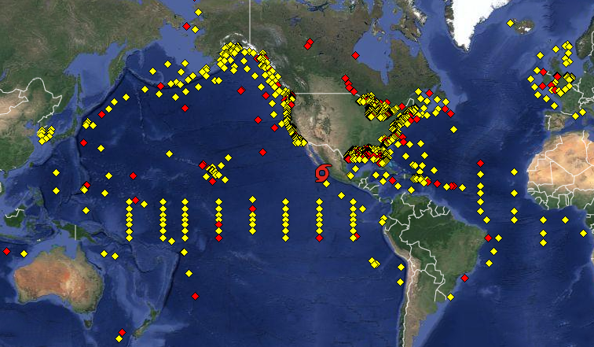
Buoys
Courtesy: NOAA’s National Data Buoy Center
Notes:
NDBC maintains and operates a global network of 250 ocean observing platforms, including moored buoys, robotic platforms and fixed stations in the Pacific and Atlantic Oceans, the Caribbean Sea, Gulf of Mexico, the Bering Sea, and in the Great Lakes.

Slide 8
Argo Floats
Notes:
3577 Floats November 4 2014
Working with multiple partners the U.S. Argo Program provides and deploys approximately half of the floats in the global Argo array, and carries out data communications and data management for those floats. U.S. Argo contributes to ongoing float technology development, and has roles in the international coordination of Argo. The U.S. Argo Program is funded by NOAA and is implemented by a partnership of five institutions: Scripps Institution of Oceanography (UCSD), the University of Washington, Woods Hole Oceanographic Institution, NOAA's Pacific Marine Environmental Laboratory, and NOAA's Atlantic Oceanographic and Meteorological Laboratory. The U.S. Navy is also a partner, providing public internet access to Argo data via one of Argo's Global Data Assembly Centers.

Slide 9
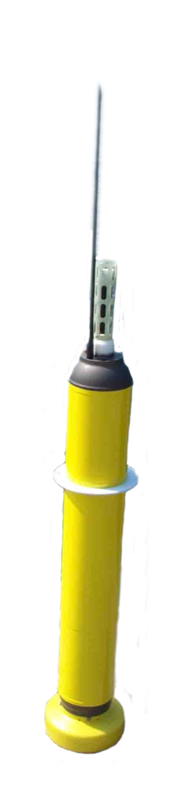
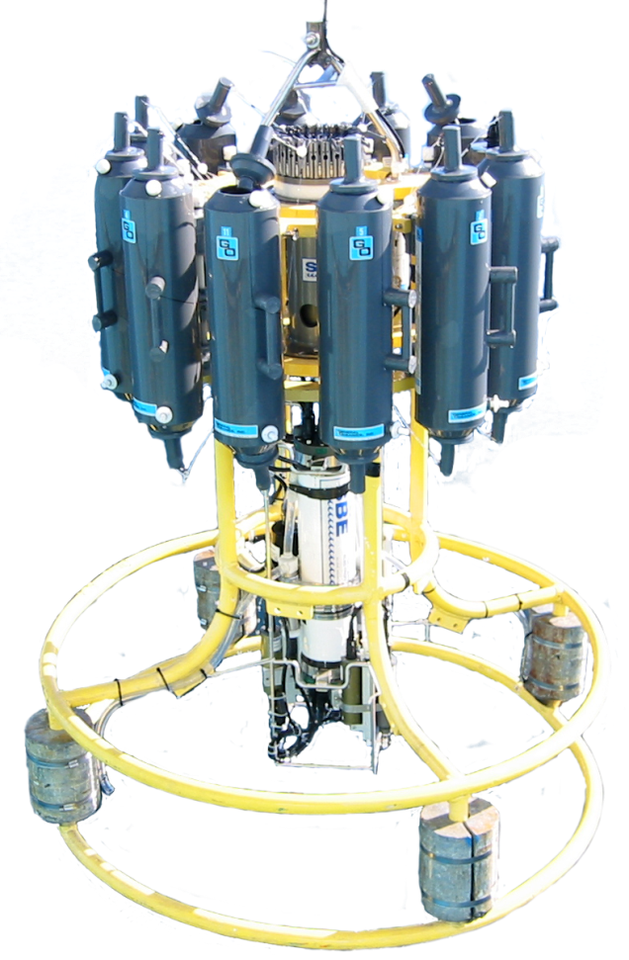
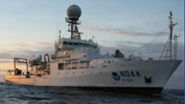
AUTONOMOUS PLATFORMS
= FORCE MULTIPLIER
$
$
*requires
$
ARGO
CTD*
NOAA RESEARCH PERSPECTIVES FOR AUTONOMOUS OCEAN TECHNOLOGIES: INMARTECH
Notes:
Main Message: Unmanned platforms may be able to serve as a force multiplier, reducing costs while increasing the efficiencies of data collection.
Innovative technologies that are agile, cost-effective, and easy to deploy and maintain are necessary to address NOAA’s observational needs, and complement and potentially reduce reliance on costly and aging current systems. NOAA currently deploys a variety of AUV technologies for individual research, development and demonstration projects. High potential exists to more fully integrate them into an operational observing system to support mission requirements for weather and ocean measurement, ecosystem assessment and hydrography and bottom characterization.

Slide 10
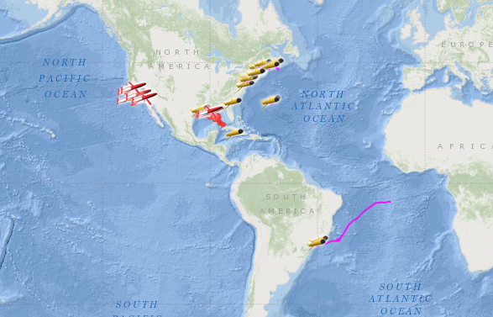
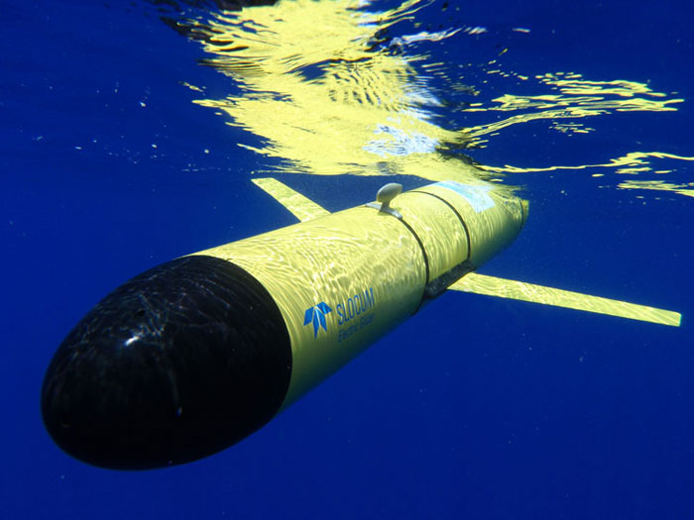
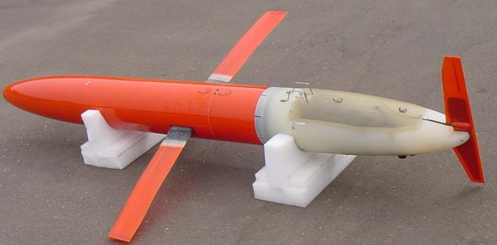

Buoyancy Gliders
Widespread use within NOAA and with NOAA partners
  Between 2008 and 2013, IOOS partners flew 33,409 glider days
SOURCE: www.ioos.noaa.gov/glider
Slocum
Notes:
IOOS glider map. Between 2008 – 2013 IOOS partners 33,409 glider days
PMEL operates 2 Slocum
Seabird non‐pumped glider CTD, Aanderaa DO optode

Slide 11
Ocean Acidification
Current methodology reliant on buoy and ship based observations
Emerging requirement for large spatial and temporal coverage
Systems must be robust and provide reliable data availability
Notes:
PMEL maintains a pool of 10+ glider pilots who serve 2‐3 day shifts and are on call 24/7
Houses a repackaged NOAA PMEL MApCO2 system = climate quality ( < 2 uatm) surface air &
surface seawater pCO2

Slide 12
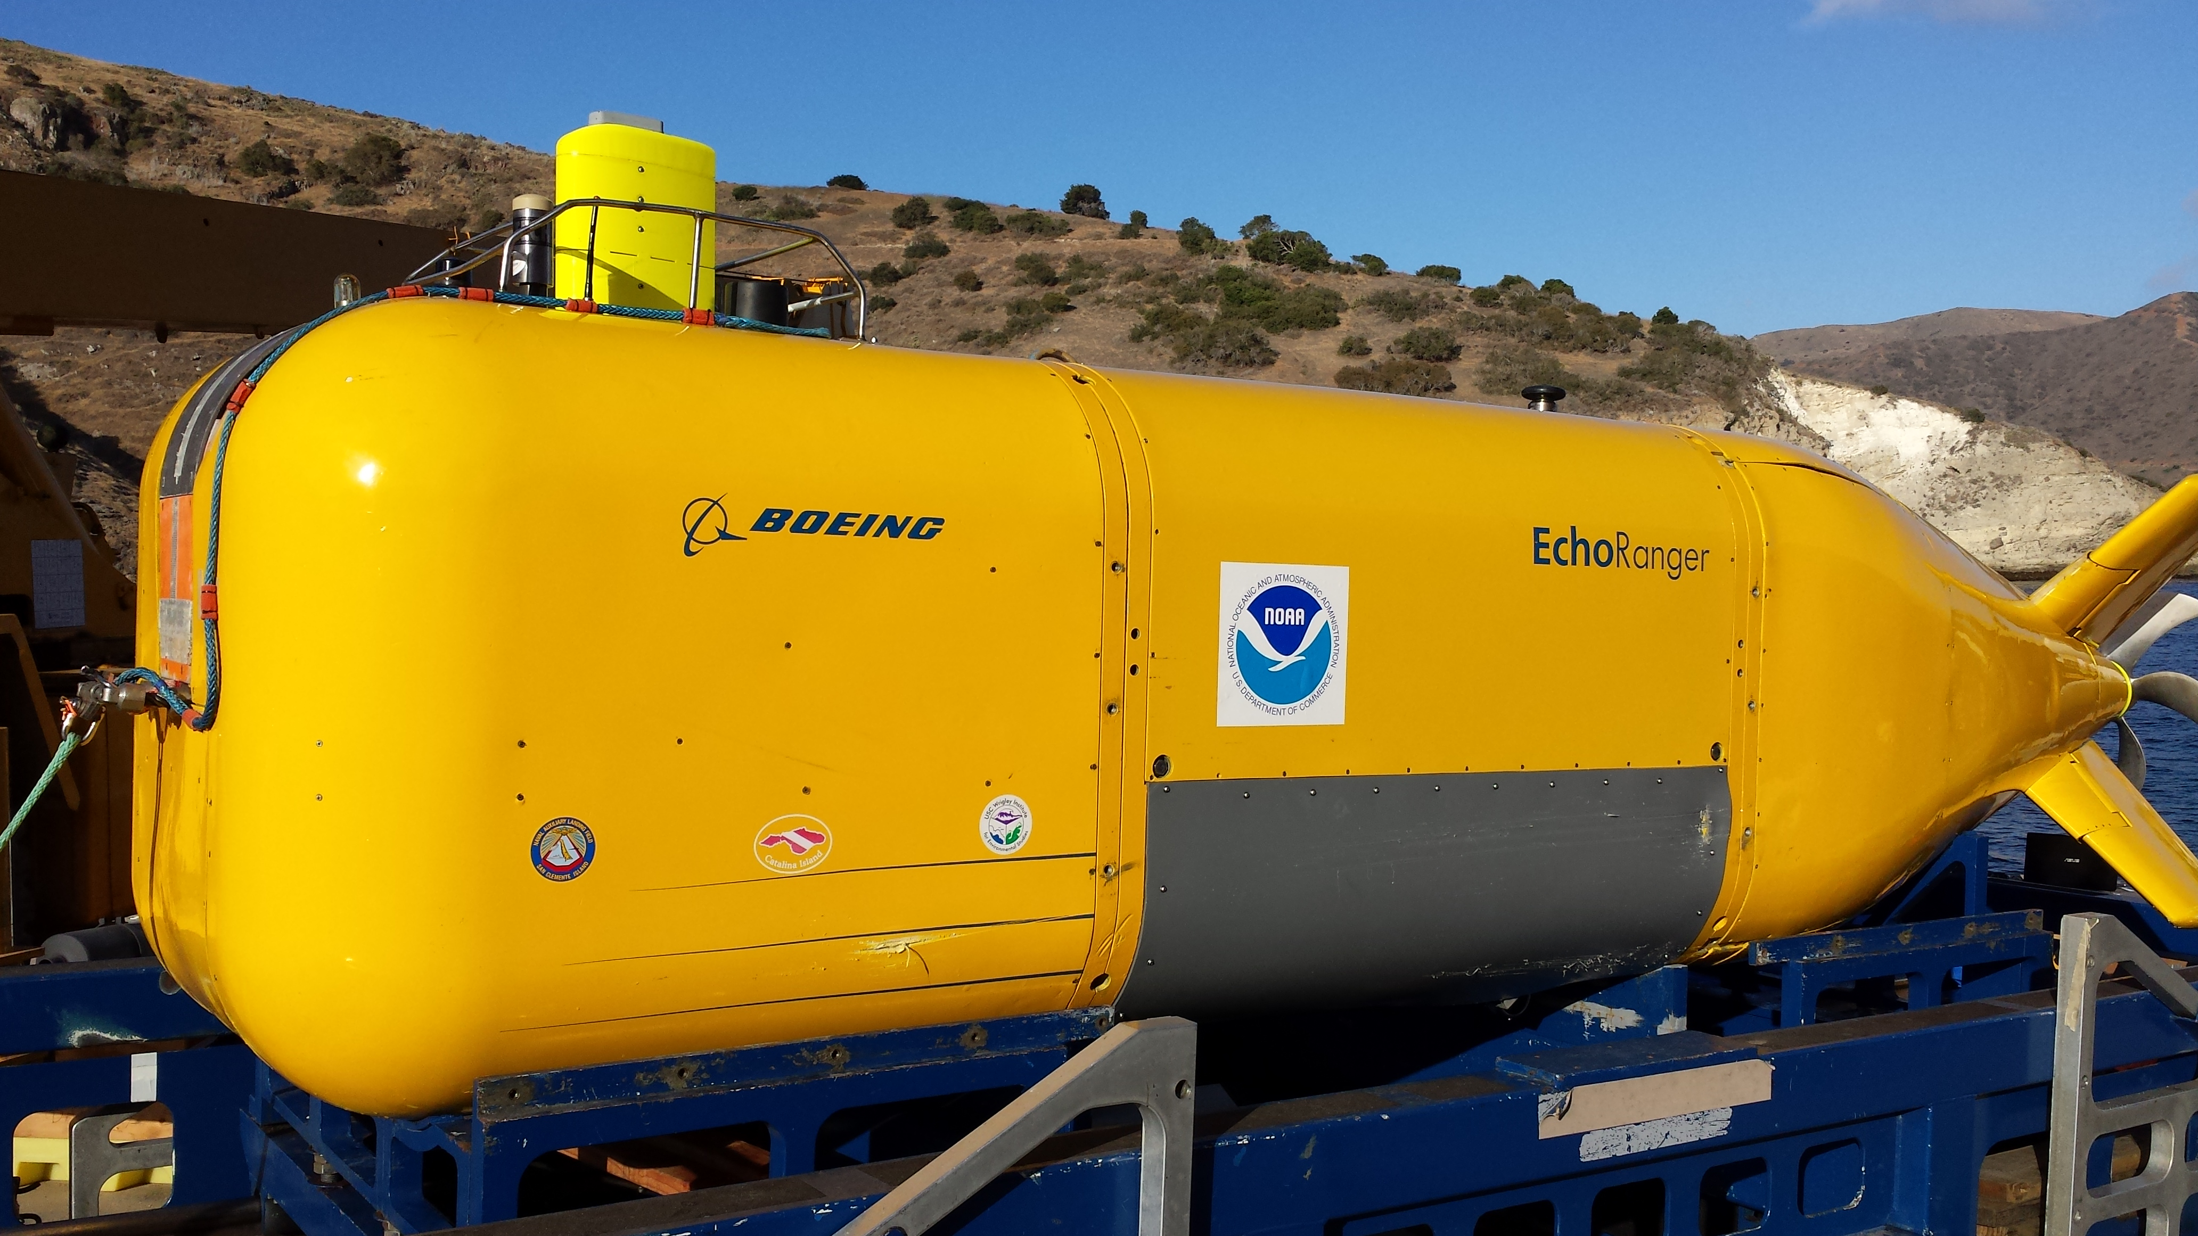
Benthic Ecosystem Assessment
Large AUV application for bottom characterization and living marine resource assessment
Longer endurance
Larger payload

Slide 13
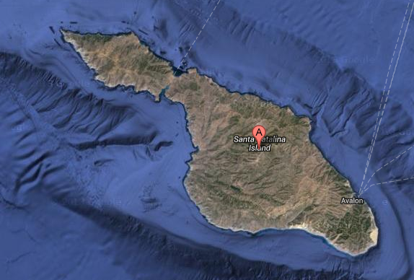
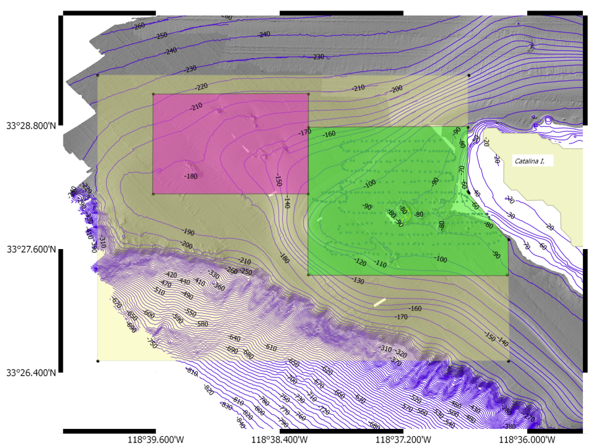
Catalina Rock Fish Assessment
Demo Sensor:
  EK60 Echosounder
  Stereo Camera package
  CTD
AUV deployed from shore
Rockfish assessment area
Echo Ranger Transit - ~6 mi
NOAA RESEARCH PERSPECTIVES FOR AUTONOMOUS OCEAN TECHNOLOGIES: INMARTECH
13

Slide 14
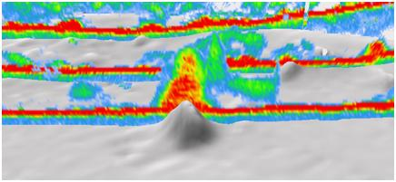
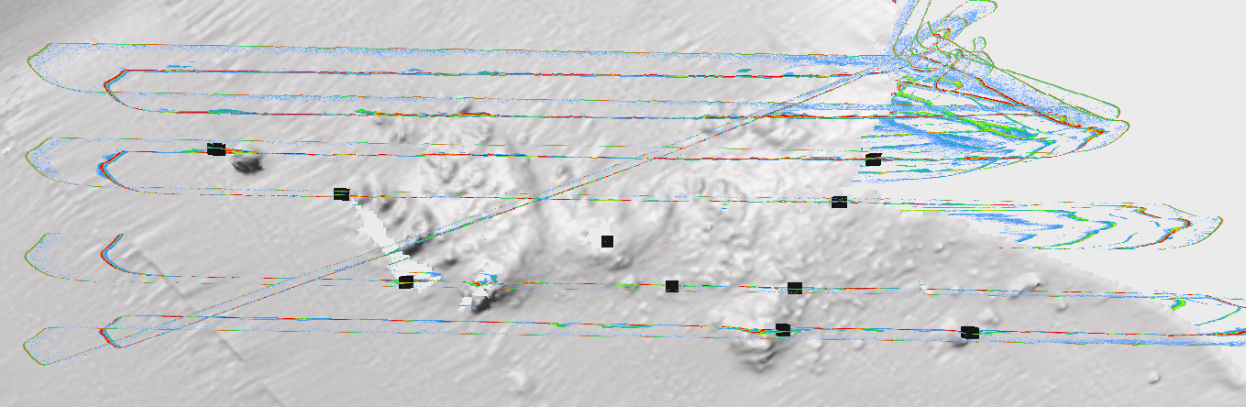
Samples of Collected Assessment Data
Assessments completed
  Echo sounder survey - constant depth of 120 ft
  Echo sounder and camera survey - 60 ft altitude
Rockfish aggregation
Echo Ranger survey track
Rockfish aggregations
NOAA RESEARCH PERSPECTIVES FOR AUTONOMOUS OCEAN TECHNOLOGIES: INMARTECH

Slide 15
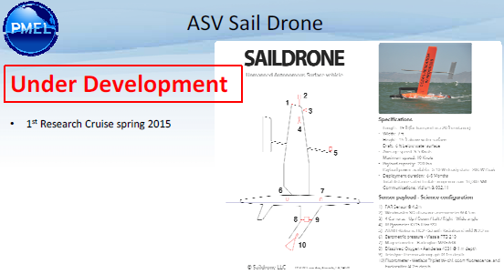
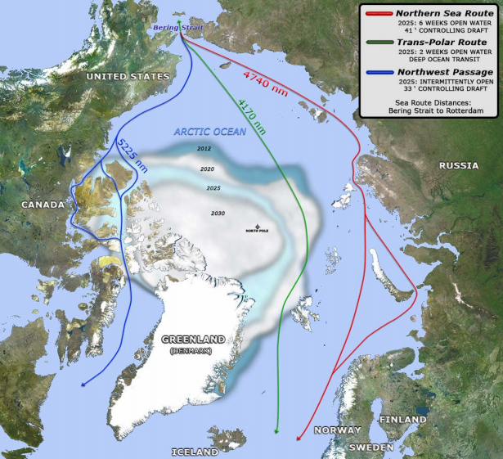
Arctic Observations: New tools needed
NOAA’s Arctic Action Strategic goals:
  Forecast sea ice
  Improve weather and water forecasts and warnings
  Understand and detect Arctic climate and ecosystem changes
  Improve stewardship and management of Arctic ocean and coastal resources
Notes:
The National Oceanic and Atmospheric Administration (NOAA) is actively engaged in the Arctic, providing science,
service, and stewardship to this rapidly changing region, its inhabitants, and the Nation. Through its broad range
of activities, NOAA is well prepared to make significant contributions, to the extent possible within existing
resources, to all three lines of effort in the recently released U.S. National Strategy for the Arctic Region (May 2013)
and its subsequent Implementation Plan (January 2014).
Likely role for unmanned maritime systems.
As described in its 2011 Arctic Vision and Strategy, NOAA
has six strategic goals in the Arctic, each of which directly supports the National Strategy – 4 of the goals depicted in slide).

Slide 16
Autonomous Technology Challenges
Platform endurance (energy)
Sensor accuracy, longevity and robustness
Business case and concept of operations
Implementing test beds for calibration between old and new methodologies
Safety – regulatory compliance, COLREGS
Notes:
Surface or subsurface – not both yet

Slide 17
Opportunities
Continued sensor and platform development
Need for skilled operators and technicians
Increased understanding of the ocean – through greater spatial and temporal measurements
New ship designs
Ocean basin infrastructure

Slide 18
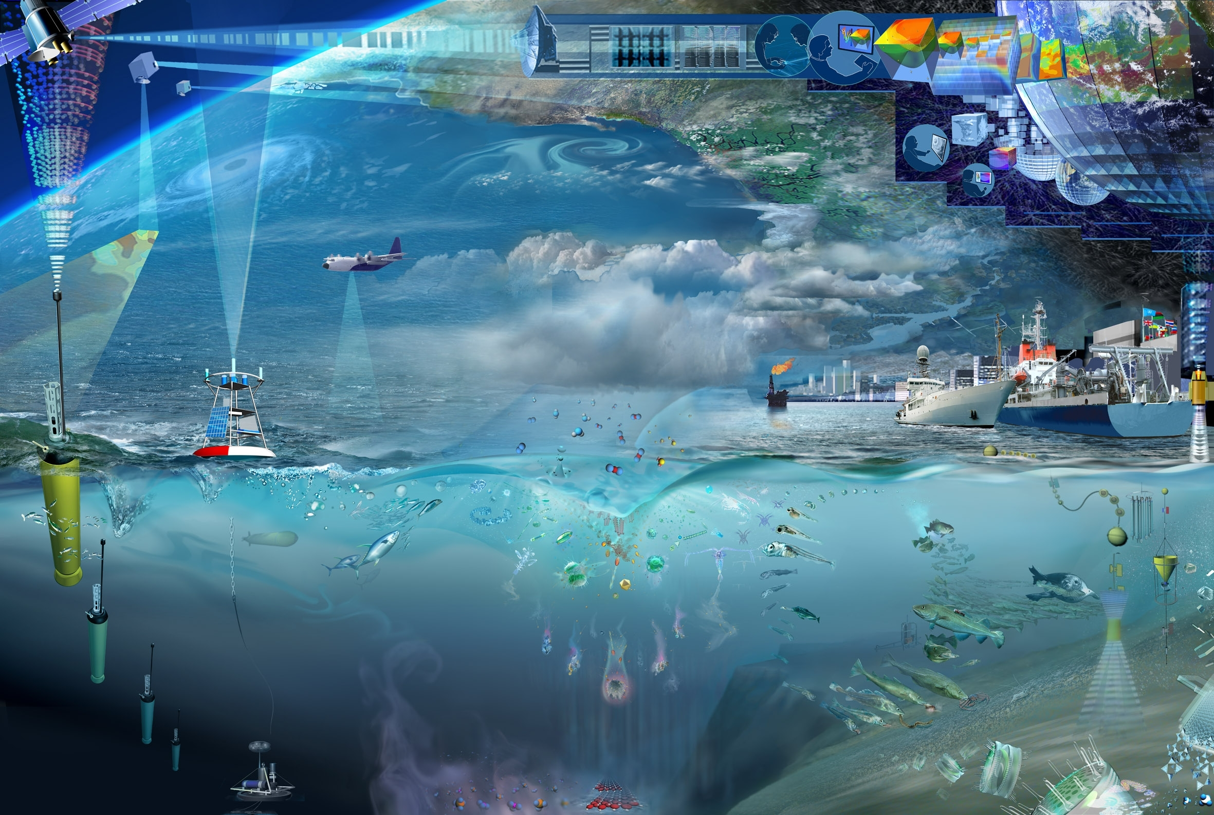
Vision: Integrated Observing
Notes:
Main Message:
In addition to developing new technologies or new uses for existing technologies, there is also the need for advancing the architecture that supports our data collection, quality control, and dissemination.
Segue:

Slide 19
Questions?
Thank you.

