Slide 2
R/V Langseth - National Facility
The R/V Marcus G. Langseth joined the U.S. academic fleet in 2008 and serves as an oceanographic research vessel, with special focus on marine seismic profiling. The Langseth is owned by NSF and operated by Columbia University’s Lamont-Doherty Earth Observatory under a cooperative agreement.
The Langseth is distinct among ships in the academic fleet in that it is a designated National Facility. This status highlights the Langseth’s key role in serving a broad community by providing a unique capability to image beneath the oceans. Unlike other ships in the fleet, the Langseth is overseen by an oversight panel, the Marcus Langseth Science Oversight Committee (MLSOC), which consists of scientists from the community and serves as a liaison between the science community, the facility operator, and the NSF.
With the R/V Langseth facility, the academic community has its first fully capable 3D seismic vessel. 3D seismic reflection imaging provides a view of the Earth’s interior that is unmatched in clarity, quality, and detail by any other method. In addition to the new 3D capabilities, the Langseth facility offers advancement to 2D imaging, both for reflection imaging and for sourcing wide-angle surveys using ocean-bottom seismometers and onshore instruments. Owing to an exceptional source array
and longer cables, the Langseth can collect 2D data that penetrates deeper and with greater clarity than ever before.

Slide 3
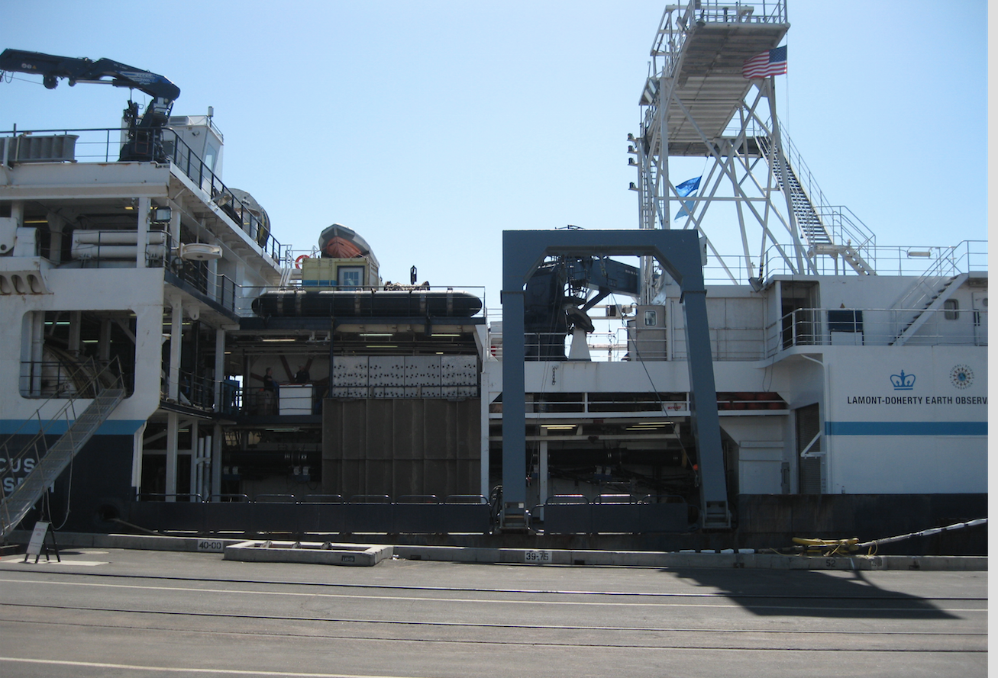
Science Community and Programs Supported
In addition to supporting investigator-driven science on these
scientific themes, the seismic imaging tool undergirds many U.S.
and international science initiatives, including:
IODP, the Integrated Ocean Drilling Program
GeoPRISMS (the MARGINS successor program)
R2K (the RIDGE 2000 initiative)
Continental Dynamics
The Ocean Bottom Seismometer Instrument Pool
IRIS/PASSCAL, including EarthScope

Slide 4
R/V Langseth - Capabilities
Facility Capabilities
The Langseth facility provides a unique combination of capabilities
for imaging the ocean, the seafloor, and the solid Earth beneath
the sea — as well as general oceanographic instrumentation.
Current shipboard equipment includes:
3D seismic capability: including four 6-km-long hydrophone streamers and dual airgun source
Long-offset capability, with possibility of towing up to an 8-km-long streamer in 2D mode
Tuned, linear source array, consisting of up to 36 airguns with a total capacity of 6600 cu. in.
Kongsberg EM122 multibeam sonar system for seafloor mapping
Knudsen 3260 Sub-Bottom Profiling
RDI 75 kHZ acoustic doppler current profiler (ADCP) to measure ocean currents
Seabird thermosalinograph to measure seawater temperature and salinity
Sippican expendable bathythermograph (XBT) launcher
Bell BGM-3 gravimeter
Towed Geometrics 882 magnetometer to measure gravity and magnetic fields
Uncontaminated Seawater System for other measurements like underway pCO2

Slide 5
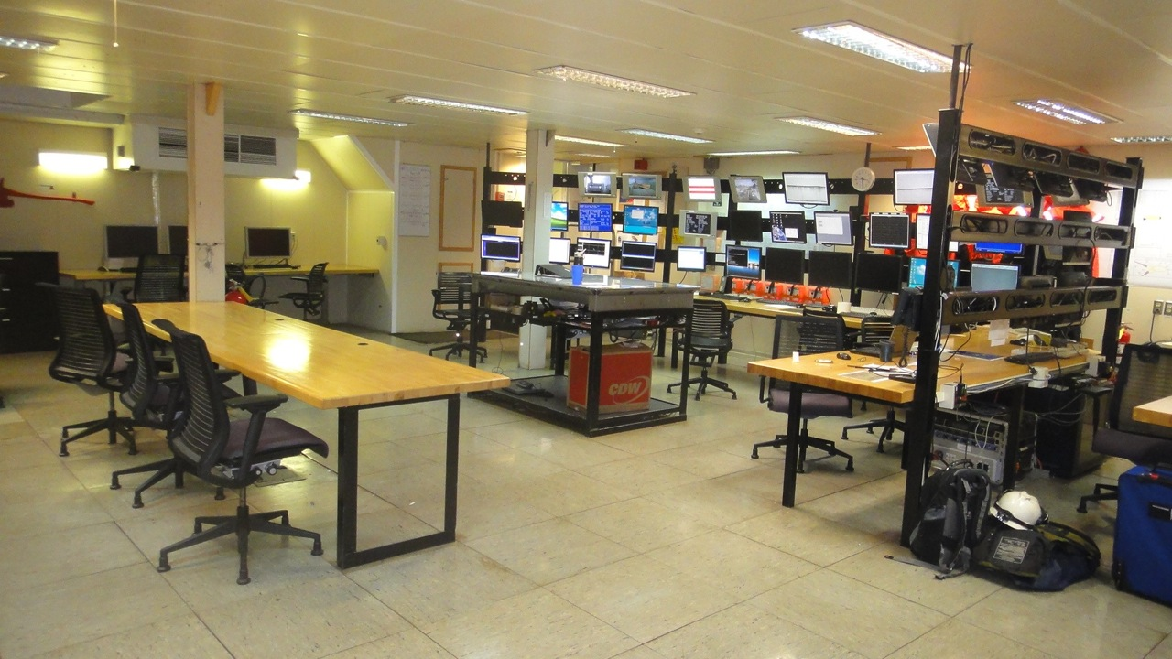
R/V Langseth - Main Lab

Slide 6
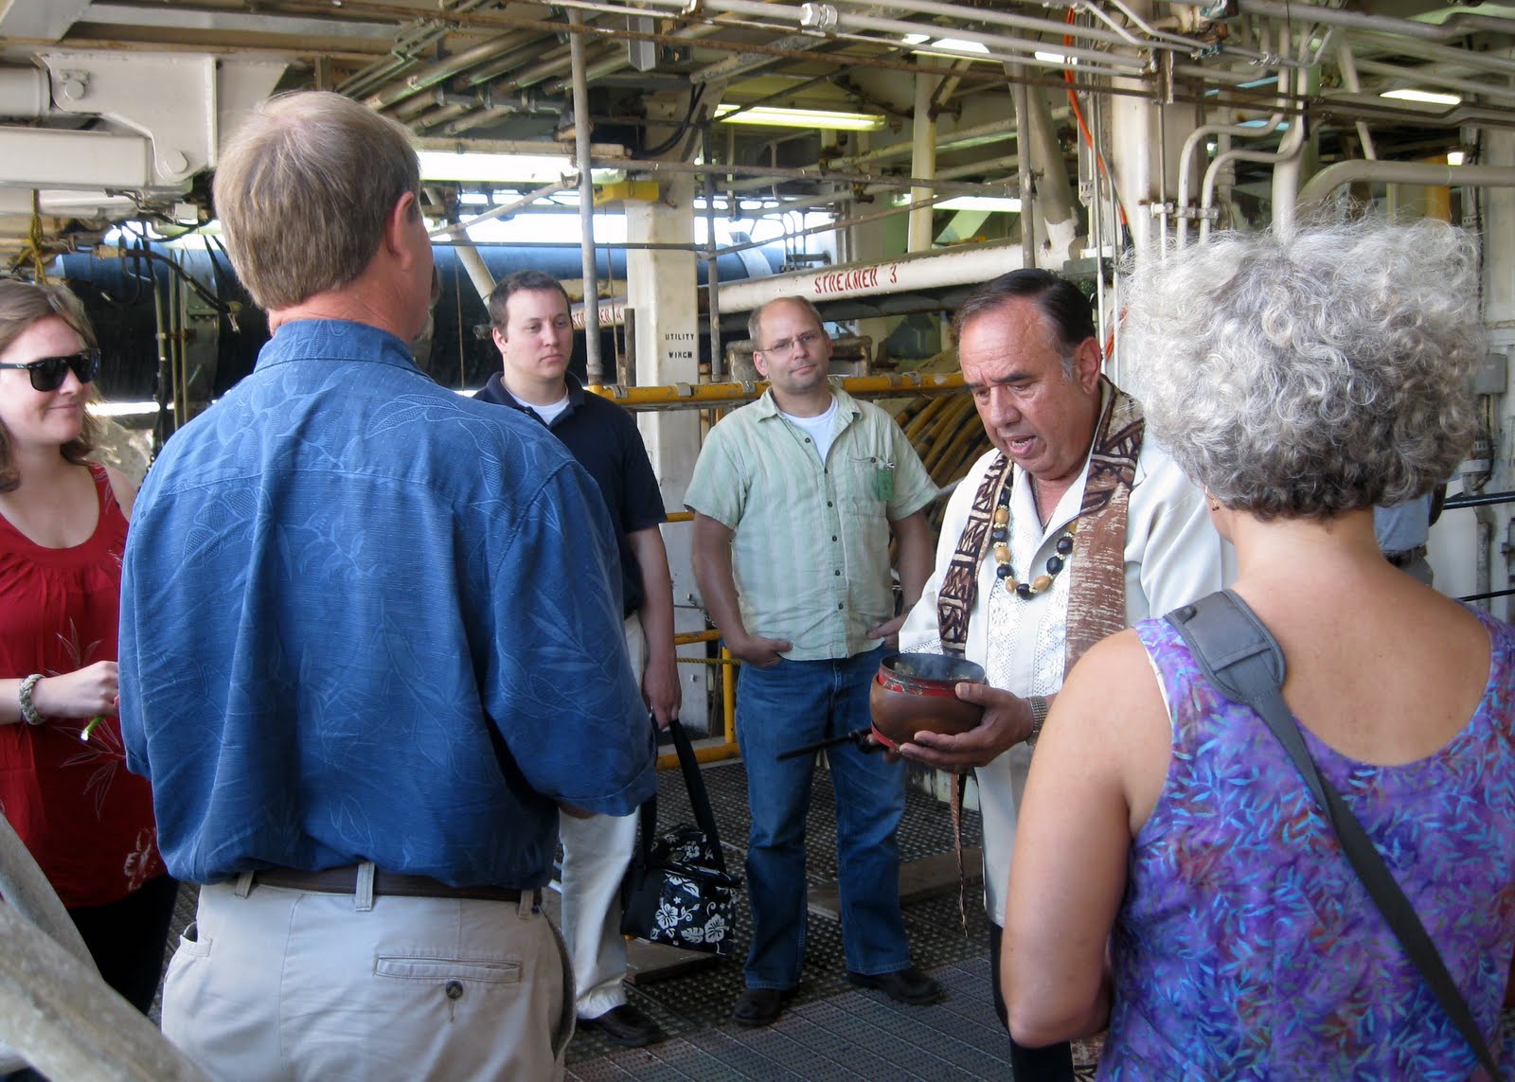
Langseth – 3rd Party Support

Slide 7
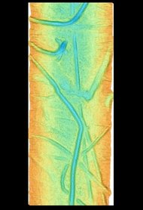
Chukchi Sea – Coakley
Processed multibeam data, showing iceberg gouges on the Chukchi Shelf. The depths are color-coded: Blue is deep and red is shallow. (Coakley, NY Times – Scientist@Work blog)
Preliminary pCO2 Data courtesy of T. Takahashi

Slide 8
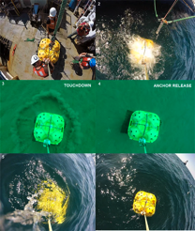
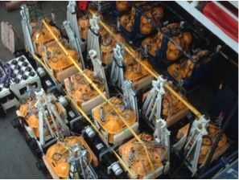
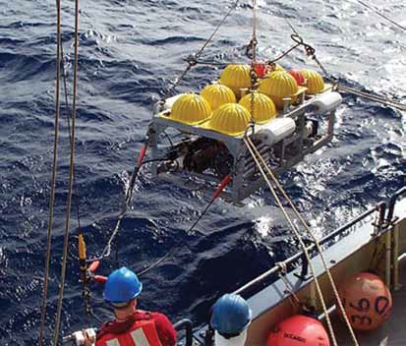
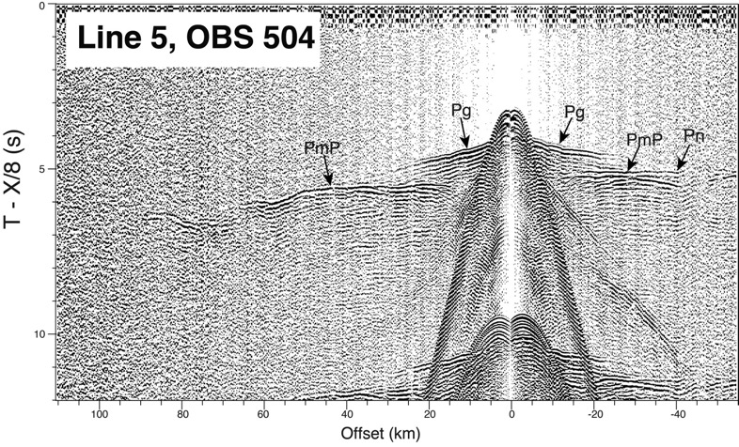
Ocean Bottom Seismometers

Slide 9
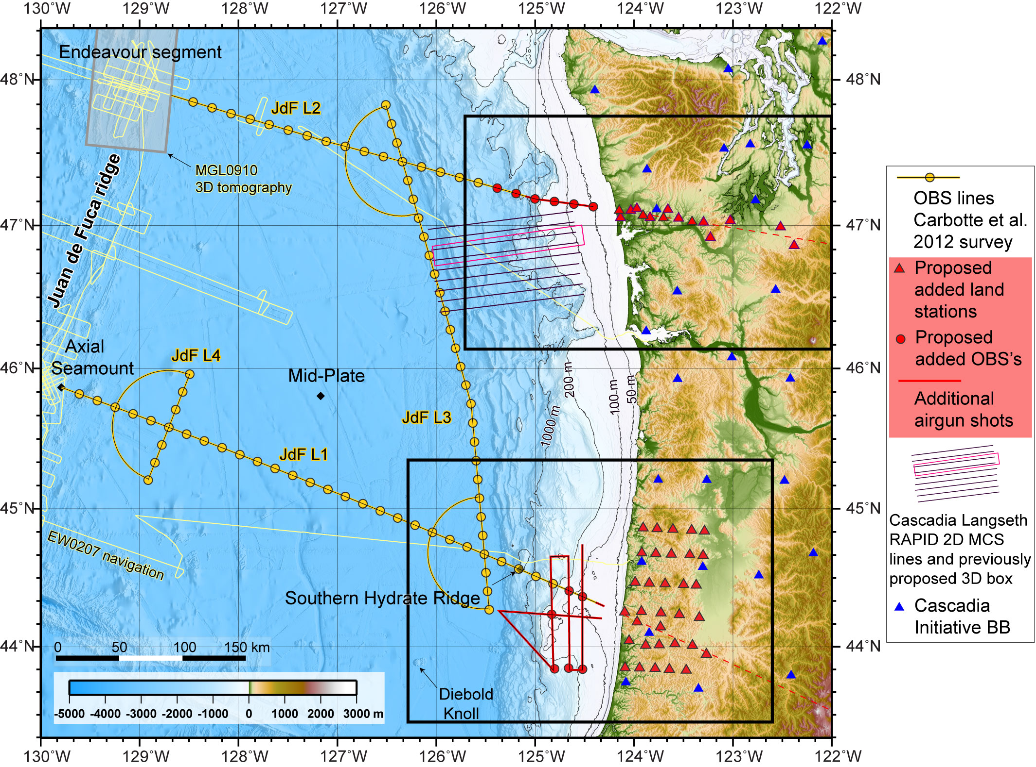
Carbotte, Trehu, Holbrook Cruises
Imaging the Juan de Fuca Plate

Slide 10
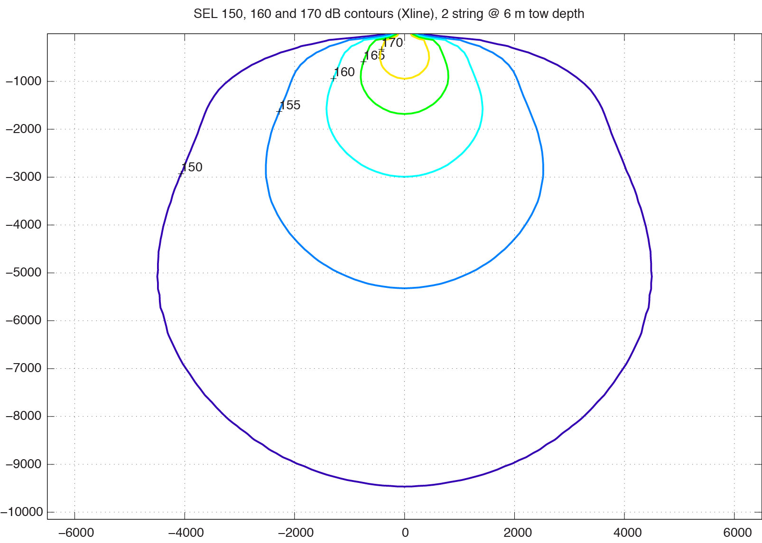
Environmental Compliance
Environmental Permitting
Every cruise funded by US agency requires
an Environmental Assessment (EA) under the National Environmental Protection Act (NEPA)
Based on analysis of that EA, NOAA Fisheries
Issues an Incidental Harassment Authorization (Marine Mammal Protection Act) and
A Biological Opinion (Endangered Species Act)

Slide 11
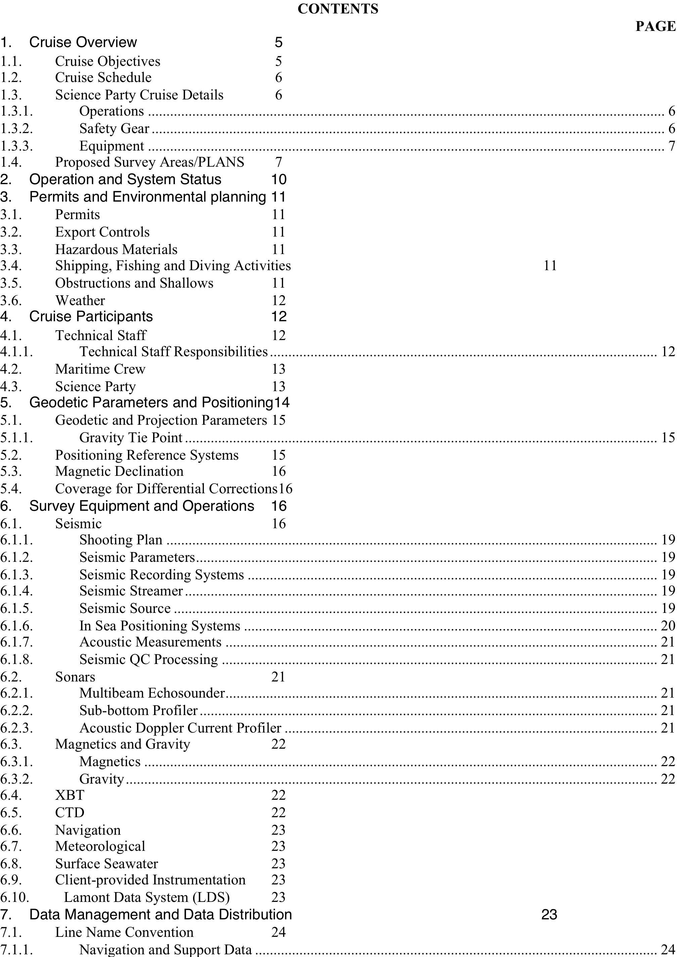
Technical Services Support

Slide 12
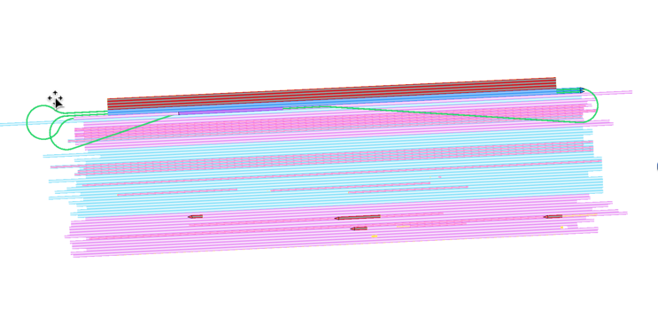
Transitioning of Long Core Facility
SurvOpt Software Output:
SurvOpt is an industry Survey Tracking/Planning Tool

Slide 13
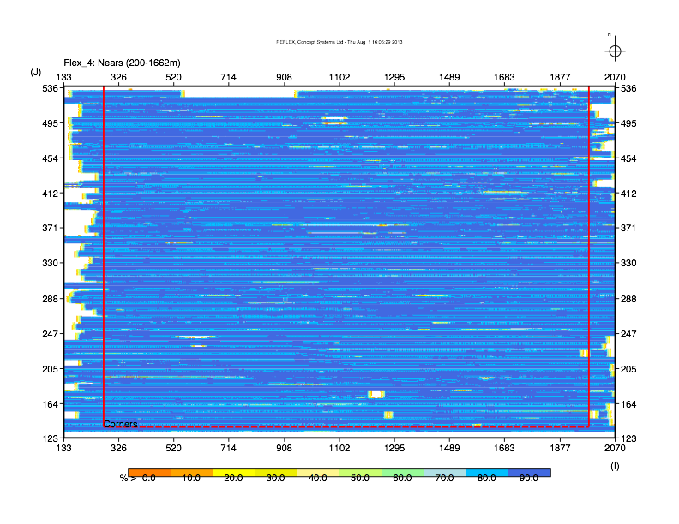
Tracking 3D Survey Coverage

Slide 14
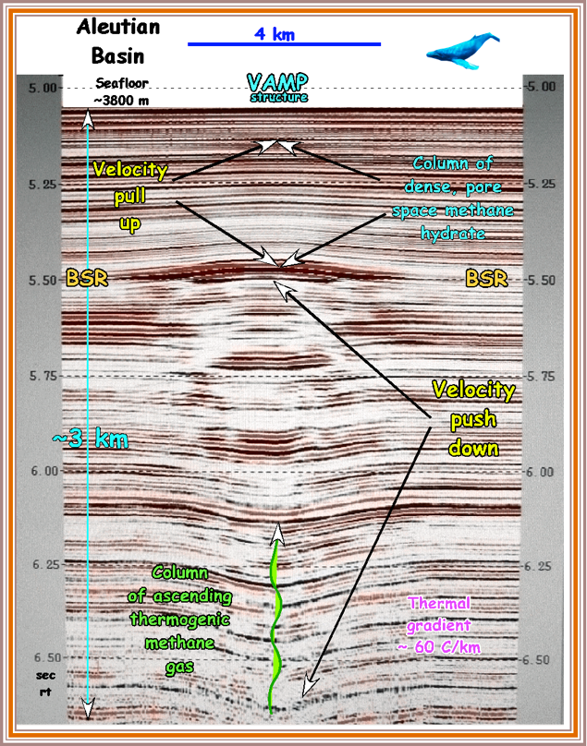
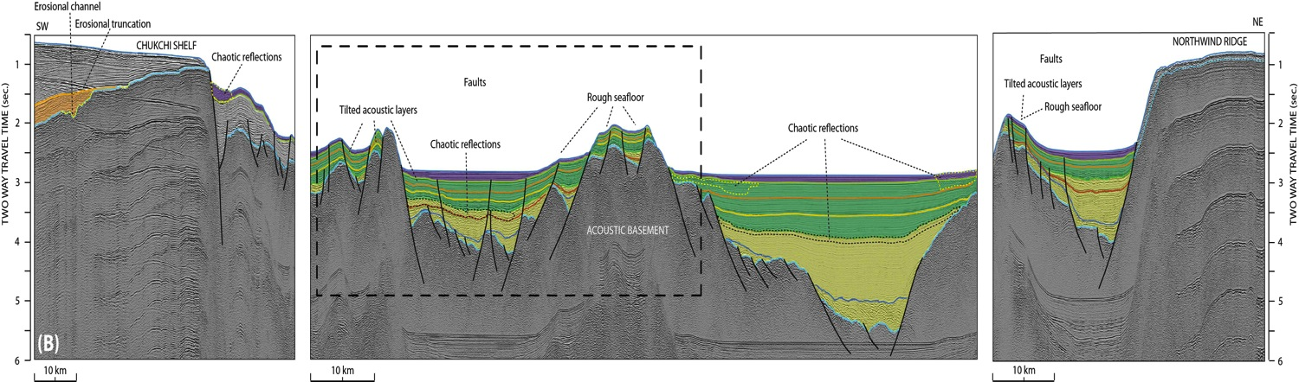
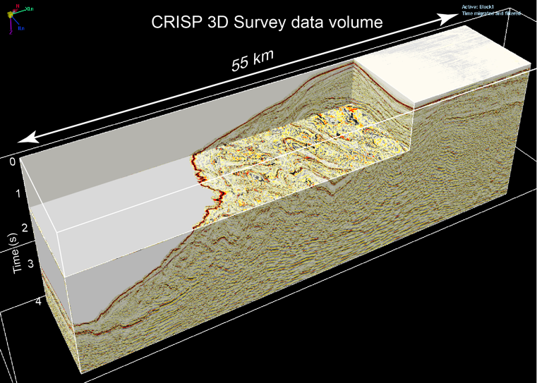
2D and 3D Products

Slide 15
Langseth: Performance Metrics
Summary Statistics:
90% Overall “Uptime” for 2011

Slide 16
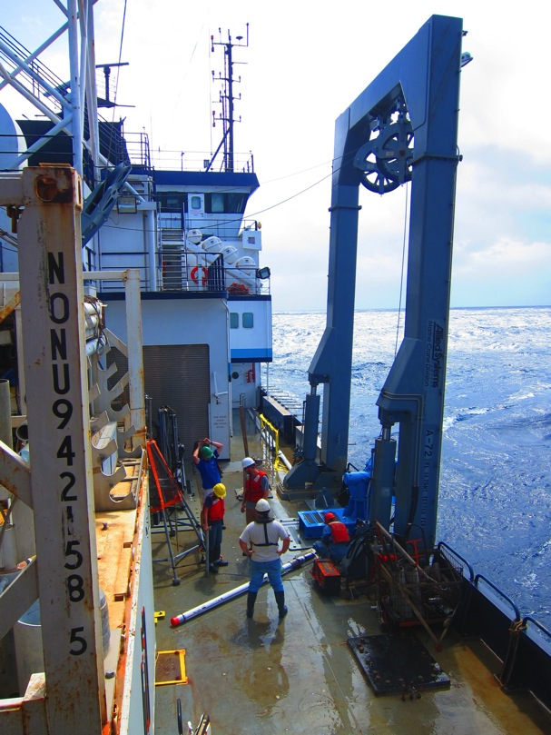
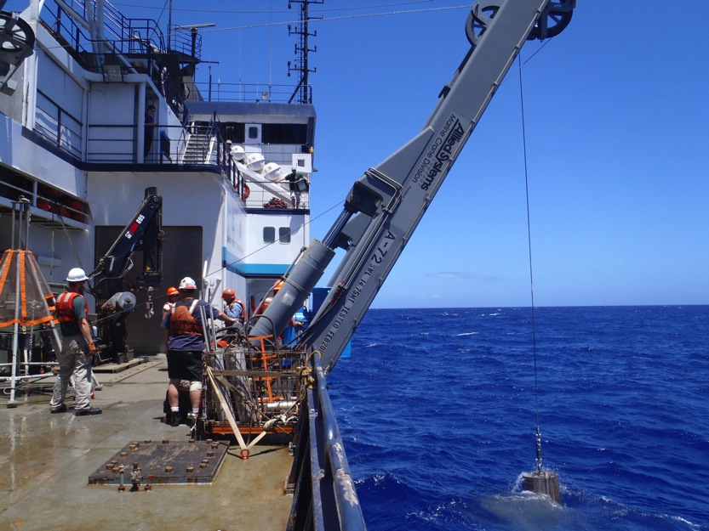
Deck Space for Line Islands Coring Cruise
The main deck space on Langseth was loaded with OSU coring equipment, MST van, Hiab
Crane, multi-corer, CTD rosette, and core support equipment

Slide 17
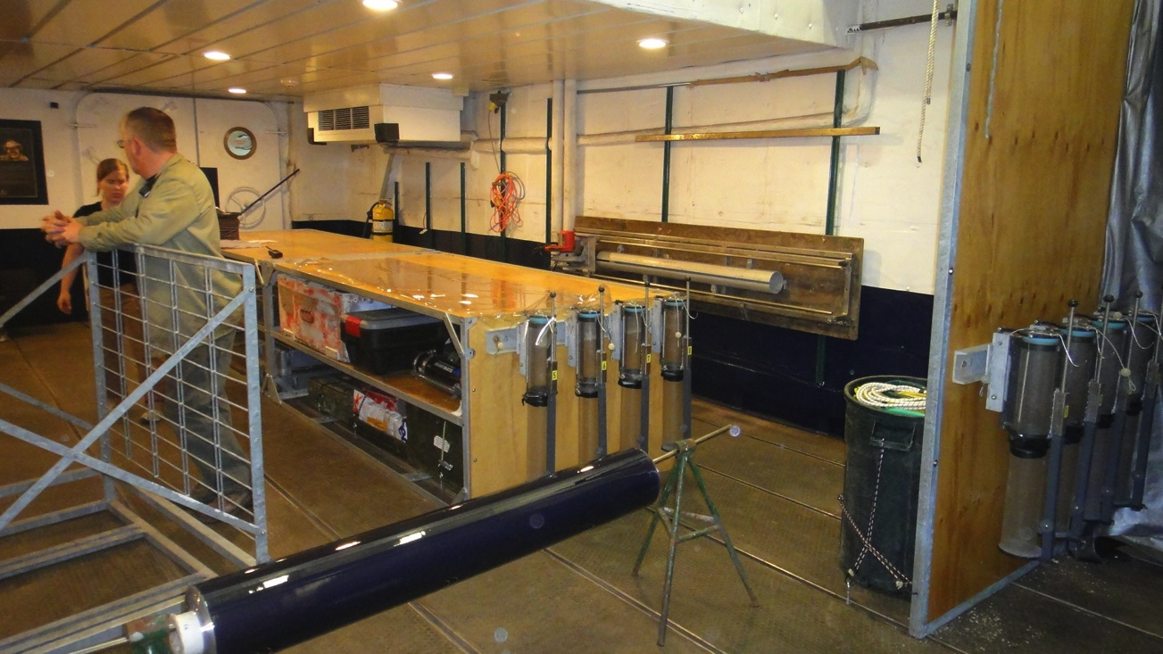
MGL12-08 – Line Islands Cruise
Starboard Side-Wet Lab Location
Core cutting/splitting
Multi-core extrusion
POC and Uncontaminated SW sampling
“We Came, We Saw, We Cored”

Slide 18
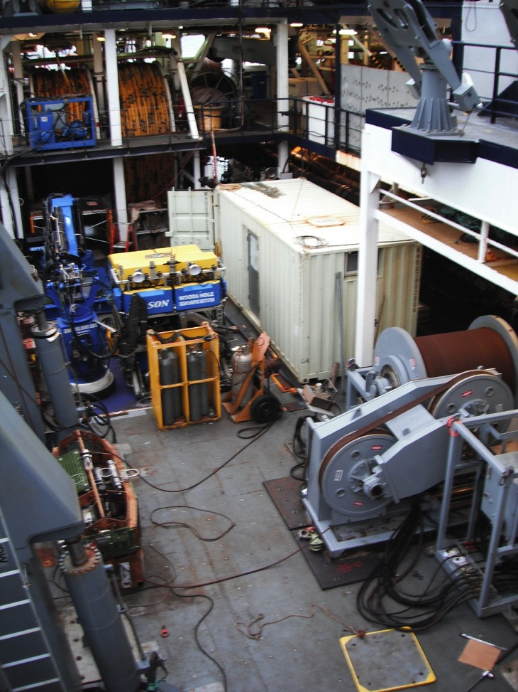
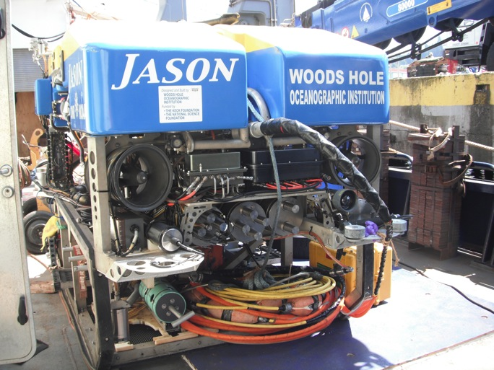
Tivey/Butterfield - JASON ROV Cruise
On right, photo of Main deck layout of Medea/winch, LARS crane, JASON and HPU, and support van.
Below, JASON on main deck..
“We Came, We Saw, We Cored”

Slide 19
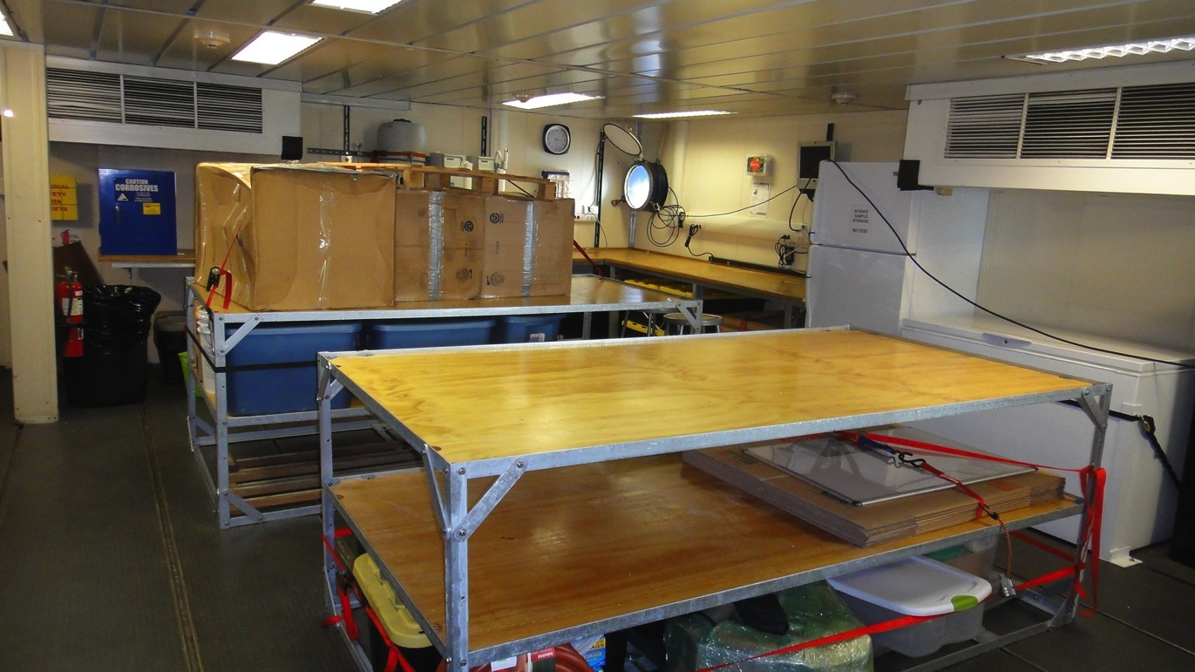
MGL12-08 – Line Islands Cruise
Starboard Side Forward Dry Lab
Lab was outfitted with new tables, refrigerator, freezer, acid cabinet, and Millipore H2O system
“We Came, We Saw, We Cored”

Slide 20
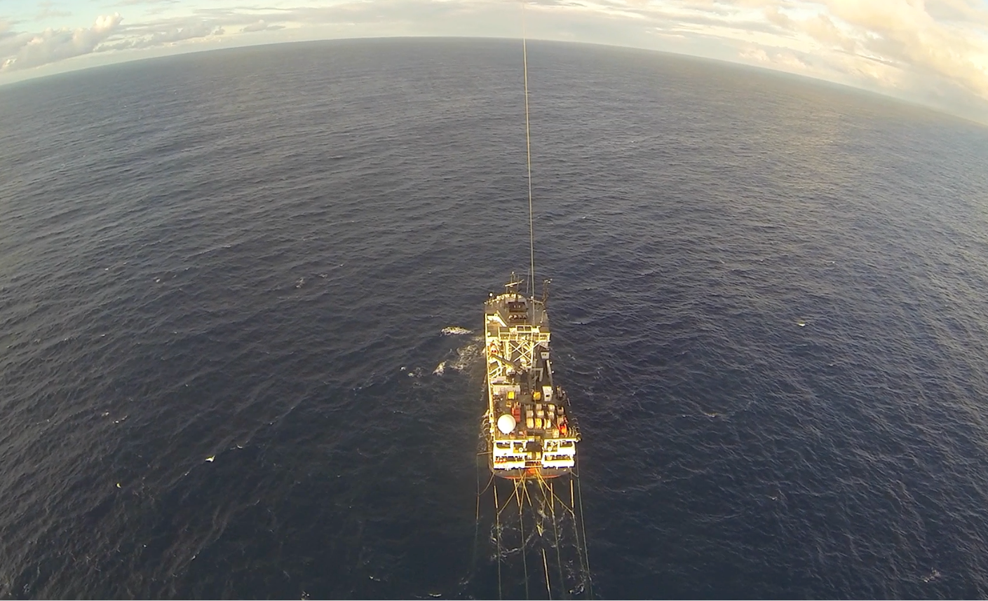
Looking Forward
“We Came, We Saw, We Cored”

